Slide 1
Scaling HDFS to more than 1 million operations per second with HopsFS
Mahmoud Ismail¹, Salman Niazi¹
Seif Haridi¹, Jim Dowling¹, Mikael Ronström²
1. KTH - Royal Institute of Technology,
^{2. Oracle}

Slide 2
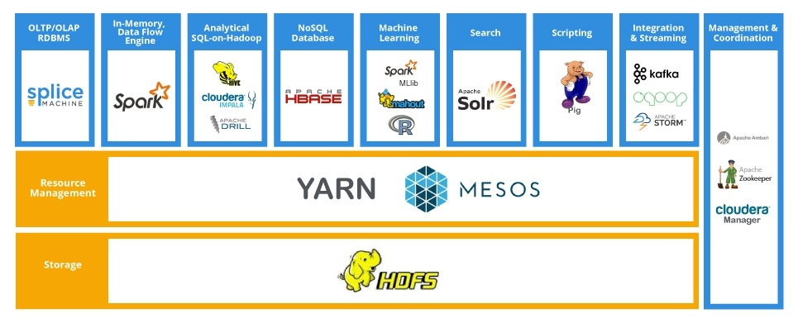
Problem
Hadoop Software Stack

Slide 3
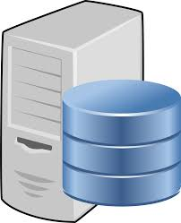
HDFS Architecture
File System Metadata
NameNode
File | Blocks Mappings
HDFS Client
File1 Blk1 → DN1, Blk2 → DN5, Blk3 → DN3
File2 Blk1 → DN1, Blk2 → DN4
File3 Blk1 → DN1, Blk2 → DN2, Blk3 → DN3
File4 Blk1 → DN100
File5 Blk1 → DN4, Blk2 → DN2, Blk3 → DN9
… … … …
FileN Blk1 → DN2, Blk2 → DN8
Where can I save the file?
DataNodes Addresses
File1
DataNodes

Slide 4
HDFS Read File Operation
File System Metadata
NameNode
File | Blocks Mappings
File1
File1 Blk1 → DN1, Blk2 → DN4, Blk3 → DN5
File1 Blk1 → DN1, Blk2 → DN5, Blk3 → DN3
Where File1 is saved?
File2 Blk1 → DN1, Blk2 → DN4
File3 Blk1 → DN1, Blk2 → DN2, Blk3 → DN3
File4 Blk1 → DN100
File5 Blk1 → DN4, Blk2 → DN2, Blk3 → DN9
… … … …
FileN Blk1 → DN2, Blk2 → DN8
DataNode

Slide 5
HDFS Performance at Scale
NameNode
DataNode

Slide 6
`

Slide 7
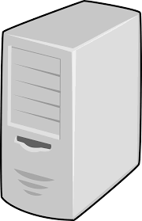
HDFS 2.0 High Availability
Standby
NameNode
NameNode
DataNodes

Slide 8
HDFS Limitations
HDFS has been scaled to store 100 PB – 200 PB on 2000 – 3000 datanodes
Namespace size upper bound: ~ 500 million files
At most 70 – 80 thousand file system operations / sec

Slide 9
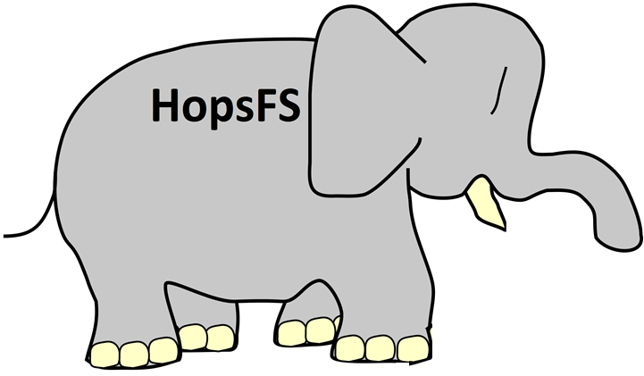
What is HopsFS?

Slide 10
Production ready >1 million ops/sec Hadoop compatible distributed hierarchical file system that can store billions of files.
H psFS
Notes:
HopsFS is all about scalability

Slide 11
Solution
HopsFS

Slide 12
HopsFS Architecture
Distributed Database
File System Metadata
File | Blocks Mappings
NameNode
File | Blocks Mappings
File1 Metadata
File2 Metadata
File | Blocks Mappings
File3 Metadata
File4 Metadata
File1 Blk1 → DN1, Blk2 → DN4, Blk3 → DN5
File2 Blk1 → DN1, Blk2 → DN4
File3 Blk1 → DN1, Blk2 → DN2, Blk3 → DN3
File | Blocks Mappings
File5 Metadata
File6 Metadata
File | Blocks Mappings
File7 Metadata
File8 Metadata
File4 Blk1 → DN100
File5 Blk1 → DN4, Blk2 → DN2, Blk3 → DN9
FileN Blk1 → DN2, Blk2 → DN8
DataNodes

Slide 13
HopsFS
Published in 15th USENIX Conference on File and Storage Technologies FAST 2017
Running in production since Summer 2016 in SICS ICE (1100 cores, 14 TB, 6 PB).
Course: ID2223

Slide 14
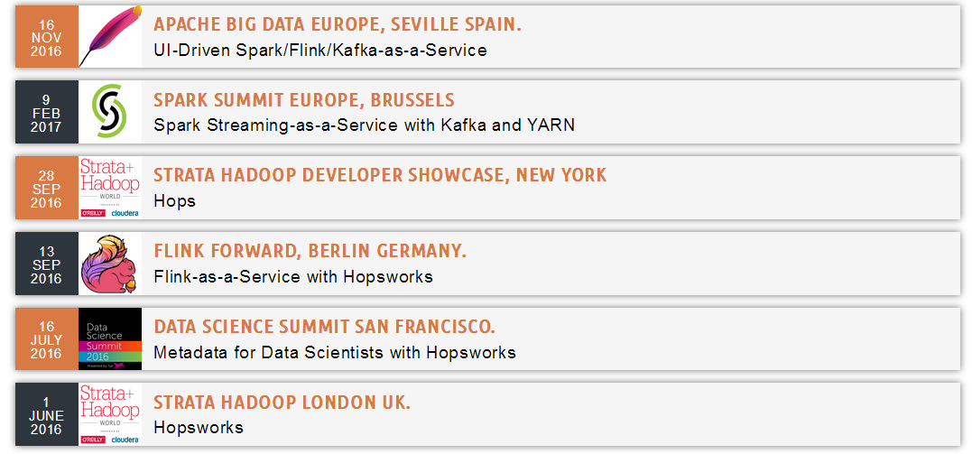
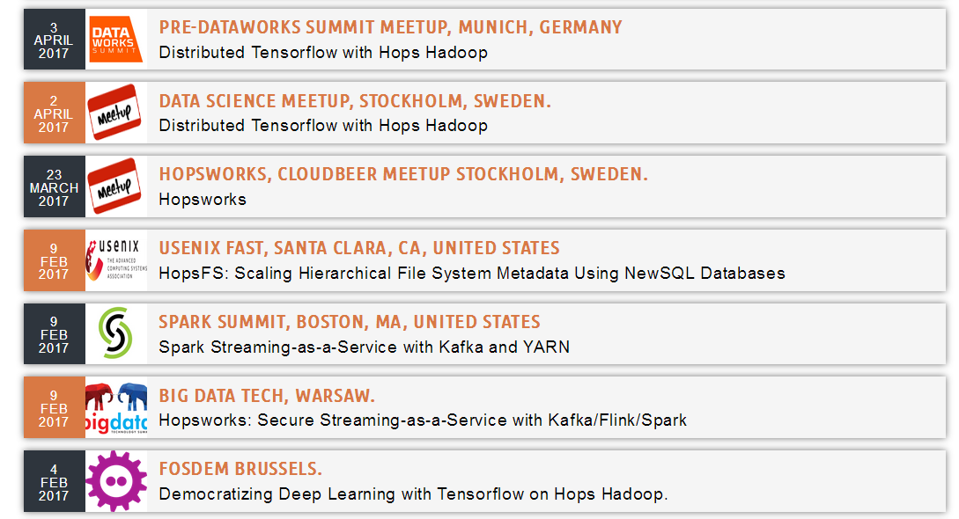
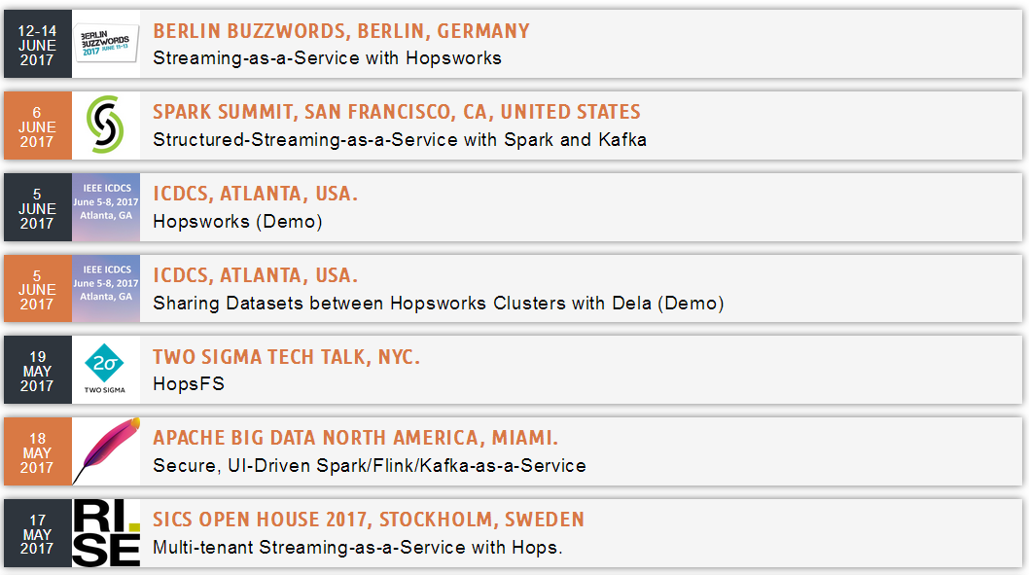
HopsFS Showcases

Slide 15
Distributed Metadata Design
DB Node 1
DB Node 2
DB Node 3
DB Node 4
Inodes
Inodes
Inodes
Inodes
/
/home
/usr
/bin
/lib
/home/A
/home/B
/usr/A
/usr/B
/bin/A
/bin/B
/lib/A
/lib/B

Slide 16
Distributed Metadata Design
TC
TC
TC
TC
DB Node 1
/home
/usr/A
/bin/B
…
DB Node 2
/home/A
/usr/B
/lib
…
DB Node 3
/home/B
/bin
/lib/A
…
DB Node 4
/usr
/bin/A
/lib/B
…
ls – l /home
/
/
/home
/usr
/bin
/lib
/home
/usr
/bin
/lib
/home/A
/home/B
/usr/A
/usr/B
/bin/A
/bin/B
/lib/A
/lib/B
/home/A
/home/B
/usr/A
/usr/B
/bin/A
/bin/B
/lib/A
/lib/B

Slide 17
Distributed Metadata Design
TC
TC
TC
TC
DB Node 1
/home
/usr/A
/bin/B
…
DB Node 2
/home/A
/usr/B
/lib
…
DB Node 3
/home/B
/bin
/lib/A
…
DB Node 4
/usr
/bin/A
/lib/B
…
ls – l /home
ls –l /home
40
50
60
40
50
60
20
80
20
80
CPU
Network
Latency

Slide 18
Distributed Full Table Scans
drwxrwx--- /home
-rwxrwx--- /home/A
-rwxrwx--- /home/B
TC
TC
TC
TC
DB Node 1
/home
/usr/A
/bin/B
…
DB Node 2
/home/A
/usr/B
/lib
…
DB Node 3
/home/B
/bin
/lib/A
…
DB Node 4
/usr
/bin/A
/lib/B
…
Full Table Scan Operations
Do not Scale
Select * from Inodes where parent = /home
Select * from Inodes where parent = /home
ls – l /home
40
50
60
40
50
60
20
80
20
80
CPU
Network
Latency

Slide 19
Distributed Index Scan Operations
drwxrwx--- /home
-rwxrwx--- /home/A
-rwxrwx--- /home/B
TC
TC
TC
TC
DB Node 1
/home
/usr/A
/bin/B
…
DB Node 2
/home/A
/usr/B
/lib
…
DB Node 3
/home/B
/bin
/lib/A
…
DB Node 4
/usr
/bin/A
/lib/B
…
Distributed Index Scan Operations
Scale Poorly
Select * from Inodes where parent = /home
WITH(INDEX(name))
Select * from Inodes where parent = /home
WITH(INDEX(name))
ls – l /home
40
50
60
40
50
60
20
80
20
80
CPU
Network
Latency

Slide 20
HopsFS Solution
Uses NewSQL Relational Database that allows
User Defined Partitioning (UDP): Take control of how the data is distributed across difference database nodes
Distribution Aware Transactions (DAT): Take control over which Transaction Coordinator handles which file system operations.

Slide 21
Solution (User Defined Partitioning)
DB Node 1
DB Node 2
DB Node 3
DB Node 4
Inodes
Inodes
Inodes
Inodes
/
/home
/usr
/bin
/lib
/home/A
/home/B
/usr/A
/usr/B
/bin/A
/bin/B
/lib/A
/lib/B

Slide 22
Solution
TC
TC
TC
TC
DB Node 1
/home
/home/A
/home/B
…
DB Node 2
/usr
/usr/A
/usr/B
…
DB Node 3
/bin
/bin/A
/bin/B
…
DB Node 4
/lib
/lib/A
/lib/B
…
/
/
/home
/usr
/bin
/lib
/home
/usr
/bin
/lib
/home/A
/home/B
/usr/A
/usr/B
/bin/A
/bin/B
/lib/A
/lib/B
/home/A
/home/B
/usr/A
/usr/B
/bin/A
/bin/B
/lib/A
/lib/B

Slide 23
Solution (Partion Pruned Index Scan Operations)
drwxrwx--- /home
-rwxrwx--- /home/A
-rwxrwx--- /home/B
TC
TC
TC
TC
DB Node 1
/home
/home/A
/home/B
…
DB Node 2
/usr
/usr/A
/usr/B
…
DB Node 3
/bin
/bin/A
/bin/B
…
DB Node 4
/lib
/lib/A
/lib/B
…
Partition Pruned Index Scan
Scales Well
Select * from Inodes where parent = /home and
Partition = 1
WITH(INDEX(name))
Select * from Inodes where parent = /home and
Partition = 1
WITH(INDEX(name))
ls – l /home
40
50
60
40
50
60
20
80
20
80
CPU
Network
Latency

Slide 24
Solution (Distribution Aware Transactions)
drwxrwx--- /home
-rwxrwx--- /home/A
-rwxrwx--- /home/B
TC
TC
TC
TC
DB Node 1
/home
/home/A
/home/B
…
DB Node 2
/usr
/usr/A
/usr/B
…
DB Node 3
/bin
/bin/A
/bin/B
…
DB Node 4
/lib
/lib/A
/lib/B
…
Distribution Aware Transactions &
Partition Pruned Index Scan
Scales Very Well
Start Transaction on Node 1
Select * from Inodes where parent = /home and
Partition = 1
WITH(INDEX(name))
Start Transaction on Node 1
Select * from Inodes where parent = /home and
Partition = 1
WITH(INDEX(name))
ls – l /home
40
50
60
40
50
60
20
80
20
80
CPU
Network
Latency

Slide 25
Solution (Contd.)
~40 Tables & hundreds of FS operations.
Most NewSQL databases do not provide serializable transaction isolation level
HopsFS uses read committed transaction isolation level and row level locks
Avoiding deadlocks in file system operation.
Pessimistic Hierarchical Locking mechanism
Implementing large file system operations that do not fit in a transaction

Slide 26
Evaluation

Slide 27
Evaluation
Workload Traces
On Premise
Dual Intel® Xeon® E5-2620 v3 @ 2.40GHz,
256 GB RAM, 4 TB Disks
10 GbE
0.1 ms ping latency between nodes

Slide 28
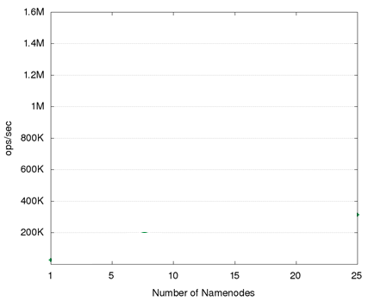
Evaluation: Industrial Workload

Slide 29
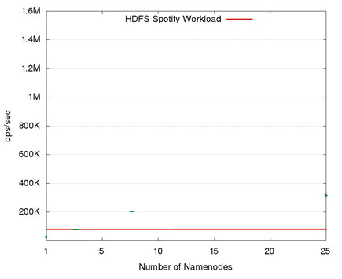
Evaluation: Industrial Workload

Slide 30
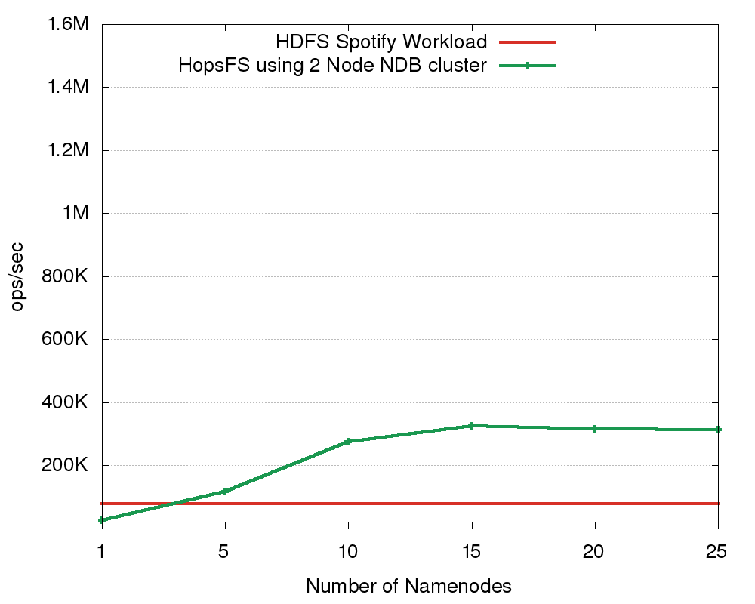
Evaluation: Industrial Workload
2 Node DB
~ 3.5X Throughput

Slide 31
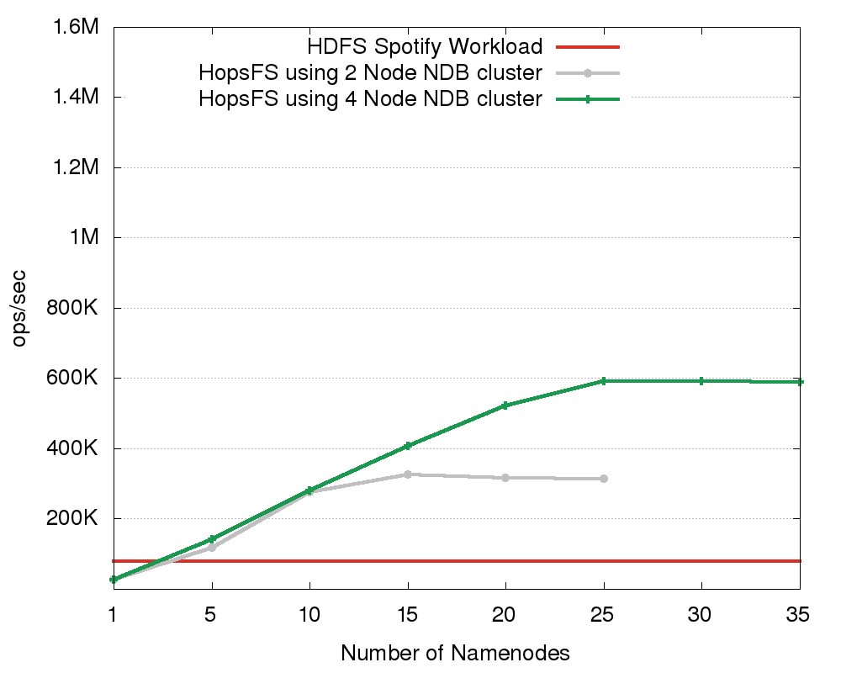
Evaluation: Industrial Workload (contd.)
4 Node DB
~ 7.5X Throughput

Slide 32
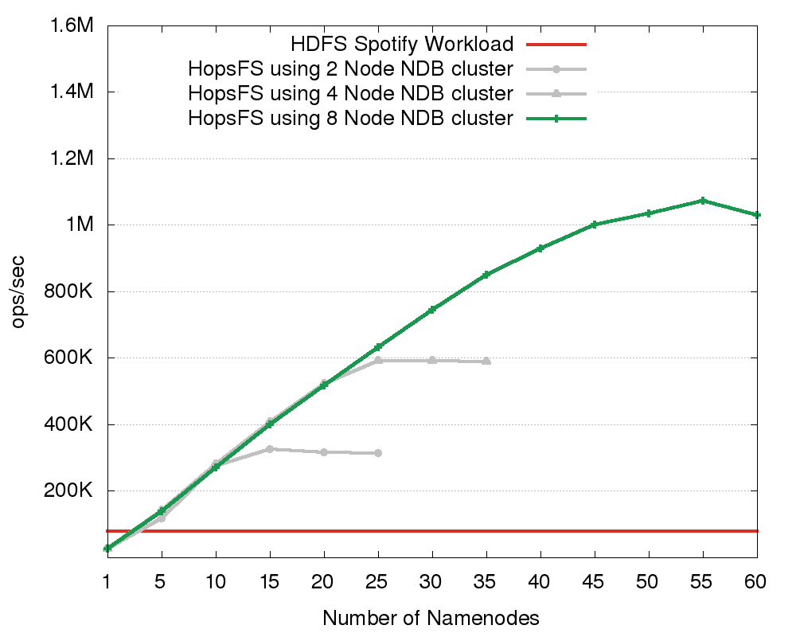
Evaluation: Industrial Workload (contd.)
8 Node DB
~ 12.5X Throughput

Slide 33
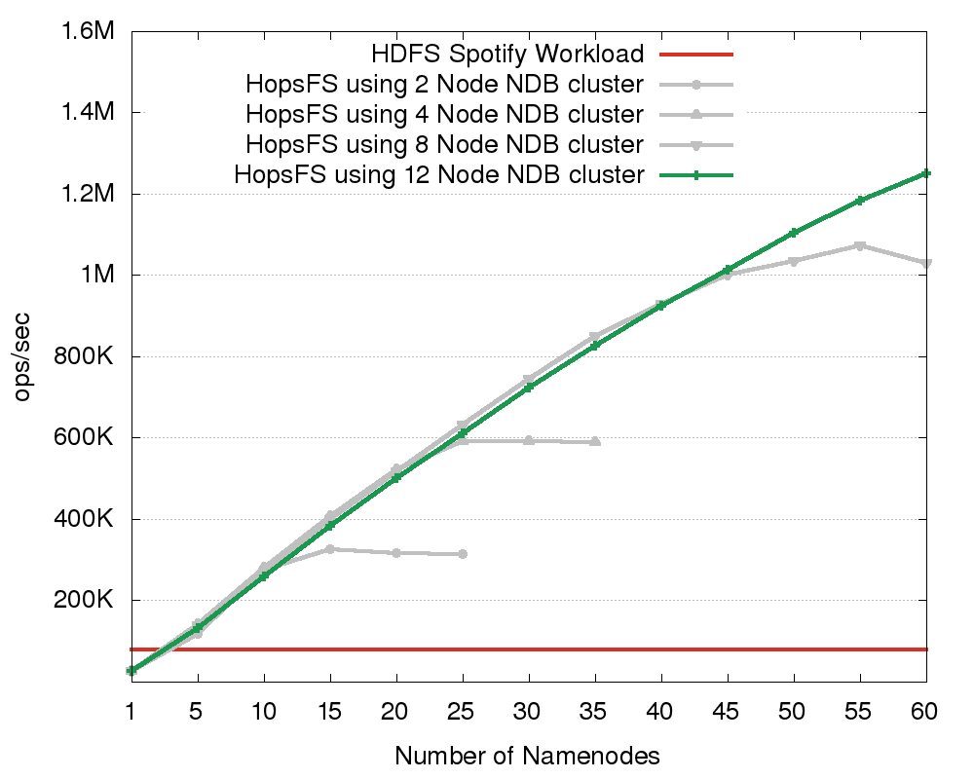
Evaluation: Industrial Workload (contd.)
Notes:
12-ndbds is a slightly lower performance that 8-ndbds, as we still have a small number of scans that don’t scale as well for larger numbers of ndbds.

Slide 34
Evaluation: Industrial Workload (contd.)
16X the performance of HDFS.
Further scaling possible with more hardware

Slide 35
Scalability of Metadata Service ( No of CPU Cores )
Number of CPU Cores

Slide 36
Write Intensive workloads
Workloads | HopsFS ops/sec | HDFS ops/sec | Scaling Factor
Synthetic Workload (5.0% File Writes) | 1.19 M | 53.6 K | 22
Synthetic Workload (10% File Writes) | 1.04 M | 35.2 K | 30
Synthetic Workload (20% File Writes) | 0.748 M | 19.9 K | 37
Scalability of HopsFS and HDFS for write intensive workloads

Slide 37
Metadata Scalability
HDFS Max 500 million files/directories
HopsFS Max 17 Billion files/directories
37 times more files than HDFS

Slide 38
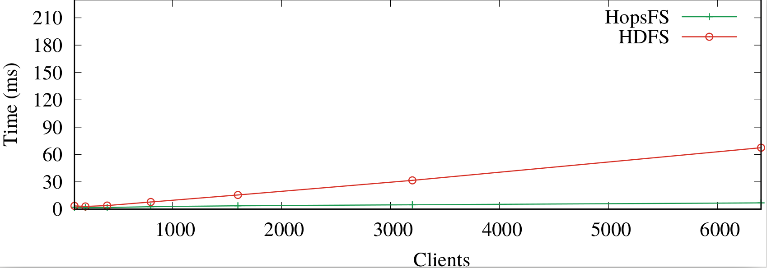
Operational Latency
File System Clients
No of Clients | HopsFS Latency | HDFS Latency
50 | 3.0 | 3.1
1500 | 3.7 | 15.5
6500 | 6.8 | 67.4

Slide 39
Operational Latency
File System Clients
For 6500 clients HopsFS has 10 times lower latency than HDFS
No of Clients | HopsFS Latency | HDFS Latency
50 | 3.0 | 3.1
1500 | 3.7 | 15.5
6500 | 6.8 | 67.4

Slide 40
Demonstration

Slide 41
Production-quality distributed hierarchical file system with transactional distributed metadata
HopsFS has 16X-37X the throughput of HDFS, with even higher throughput possible with more hardware
Conclusion
HopsFS
HDFS
Notes:
HopsFS is all about scalability

Slide 42
HopsFS High Throughput
6 Node Database
Setup
Distributed Database
MySQL NDB
36 NameNodes
20 Thousand Clients

Slide 43
System Demonstration
Realtime
Application
logs
Every 2 second writes a
Parquet format file
streams logs
consumes logs
H psFS
reads and processes
the parquet files

Slide 44
Questions
http://www.hops.io
http://github.com/hopshadoop
@hopshadoop

Slide 45
Backup Slides

Slide 46
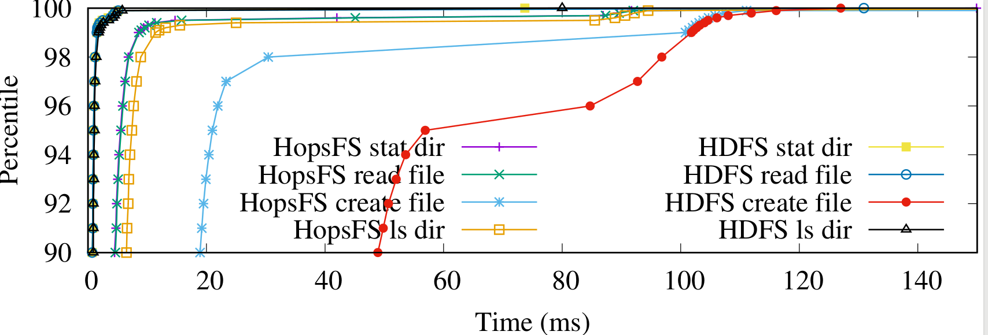
Operational Latency
Operation | HopsFS(ms) | HDFS(ms)
Create File | 100.8 | 101.8
Read File | 8.6 | 1.5
ls dir | 11.4 | 0.9
stat | 8.5 | 1.5
99th Percentiles

Slide 47
Subtree operations

Slide 48
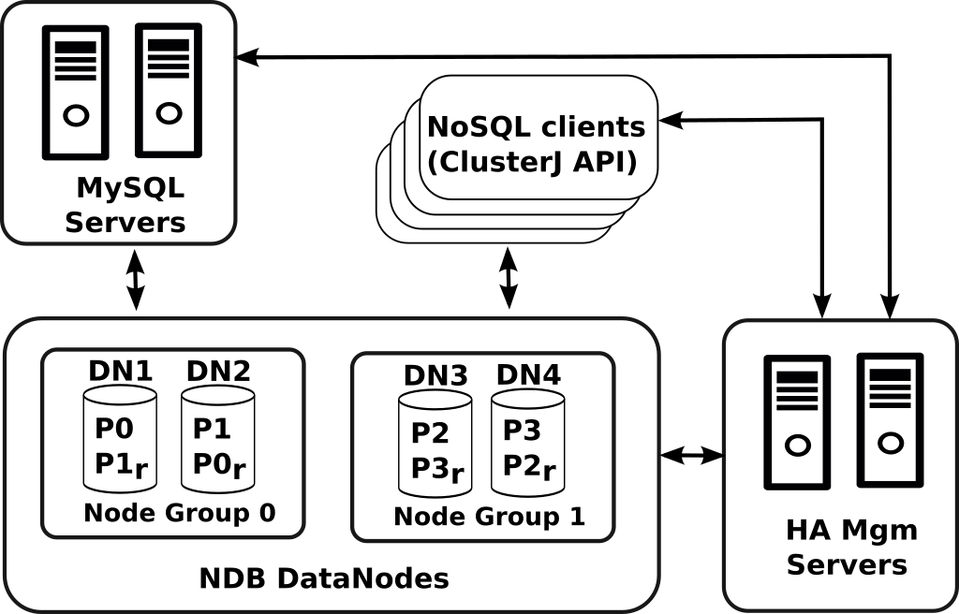
NDB Architecture
A Global Checkpoint occurs every few seconds, when transactions for all nodes are synchronized and the redo-log is flushed to disk.

Slide 49
Transaction Isolation Levels, Read Phenomena
Isolation level | Dirty reads | Non-repeatable reads | Phantoms
Read Uncommitted | may occur | may occur | may occur
Read Committed | - | may occur | may occur
Repeatable Read | - | - | may occur
Serializable | - | - | -

Slide 50
MySQL Cluster Network Database Engine (NDB)
NewSQL (Relational) DB
User-defined partitioning
Row-level Locking
Distribution-aware transactions
Partition-pruned Index Scans
Batched Primary Key Operations
Commodity Hardware
Scales to 48 database nodes
In-memory, but supports on-disk columns
SQL API
C++/Java Native API
C++ Event API

